Slide 1
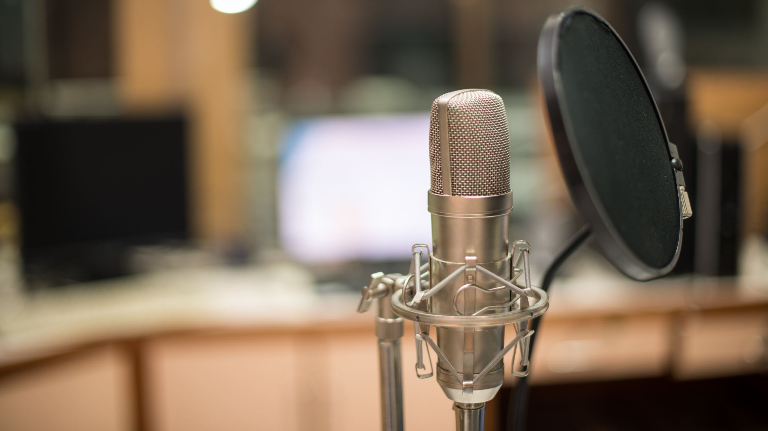
Recording Classroom Teaching
Digital Learning Team

Slide 2
Headlines
Teaching of new material should be recorded (Recording of Taught Sessions Code of Practice)
Webcams and microphones installed in all standard classrooms and most other rooms
Some labs and specialist spaces may not have been set up
Most visualisers can be recorded too

Slide 3
Recording Software
Pure recording options
Panopto
ScreenPal*
Interactive options†
Collaborate
Teams‡
* not recommended as need to manually upload
† use of interactive aspects not required but can be used if desired.
‡ recordings expire after 60 days so need to be moved

Slide 4
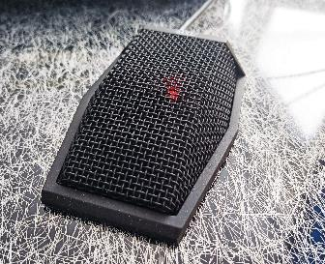
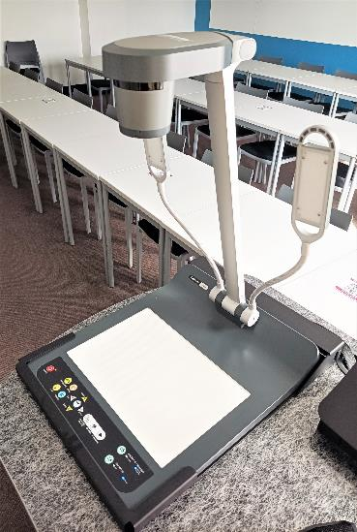
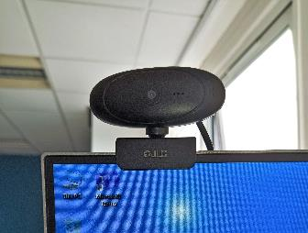
Equipment in rooms
All Classrooms (not labs)
Boundary/conference microphone on lectern
~10+ foot range in all directions
Webcam on monitor
Pointed forward but can remove and reposition
Most Classrooms
Visualiser
Can be recorded as additional webcam
Some Meeting rooms
Video conferencing
Acts as a webcam and microphone

Slide 5
Settings for all software
Microphone – USB audio CODEC or Samson UB1
Webcam – Default webcam or Logitech Webcam C930e

Slide 6
Panopto
Access on Desktop or Blackboard
Set up as you normally would:
Select camera, microphone and screen/application
Start recording and put Panopto window in background
Stop recording when done and wait a few seconds for upload
Access on any computer through web later for editing and publishing

Slide 7
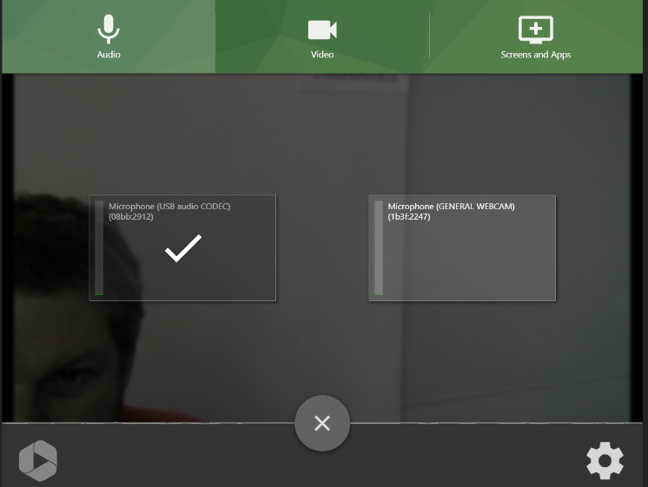
Panopto settings

Slide 8
Collaborate
Access through Blackboard module as normal
Set up as usual:
Select camera, microphone and screen/application
Start recording and put window in background
Stop recording when done
Access on any computer through web later for editing and publishing to share or upload to Panopto for editing/publishing

Slide 9
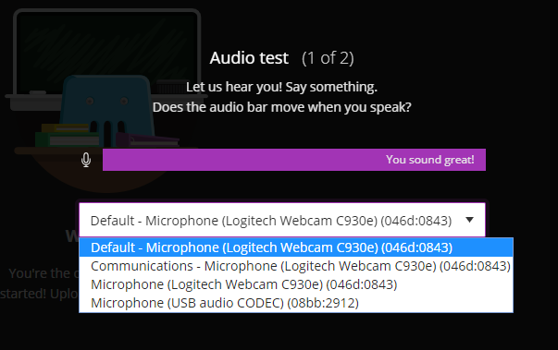
Collaborate settings

Slide 10
Teams
Open a meeting as you normally would
Set up as usual:
Select camera and microphone on entry then share screen when in meeting
Start recording and put window in background
Stop recording when done
Download later from teams for editing and publishing through Panopto

Slide 11
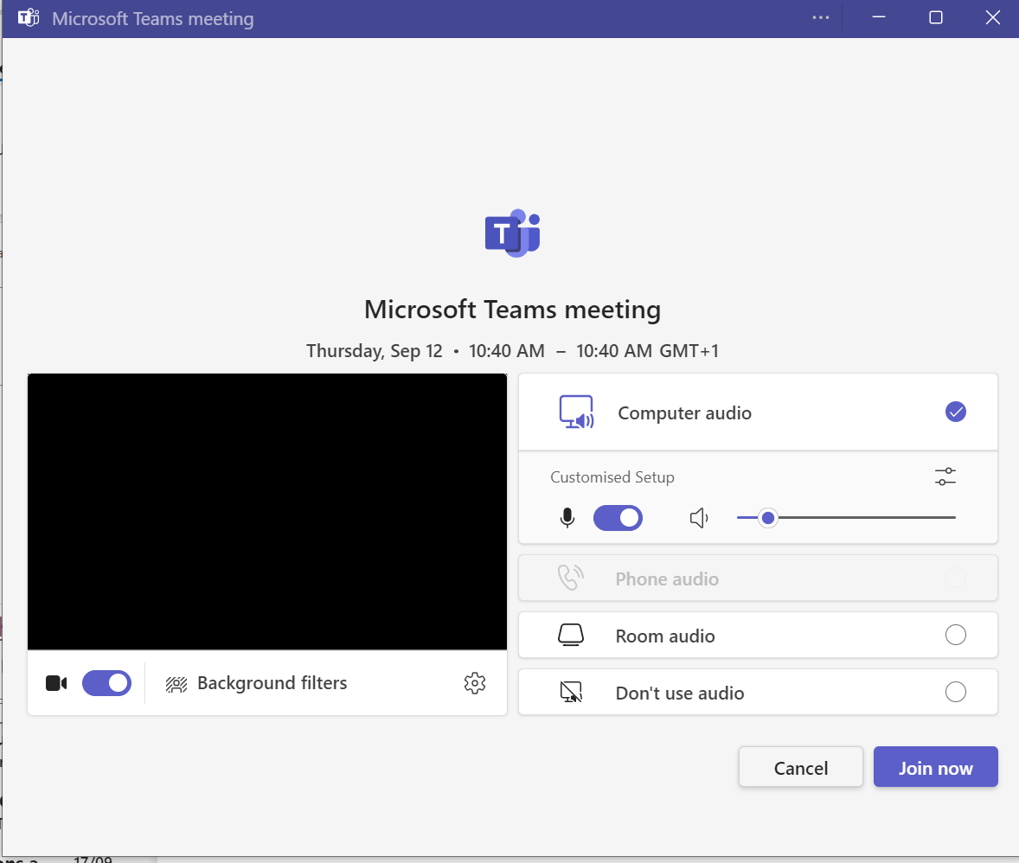
Teams settings

Slide 12
Recording visualisers
Write and draw on paper under Visualiser rather than use a whiteboard and it can be recorded.
Most visualisers have been set up as Webcams
so can be recorded or shared with any of the above tools
Will appear as another webcam when switched on
Can then display in room with Lectern panel
Some visualisers have rotatable cameras, others are fixed

Slide 13
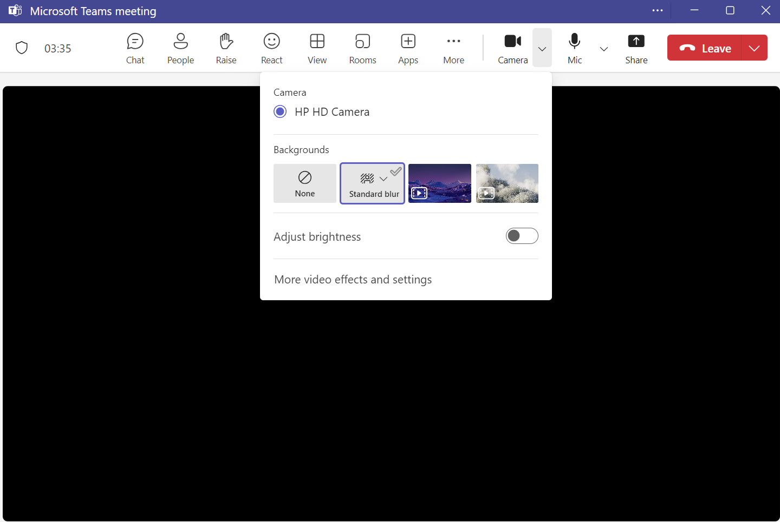
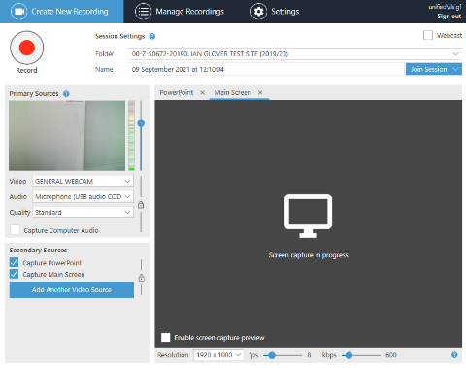
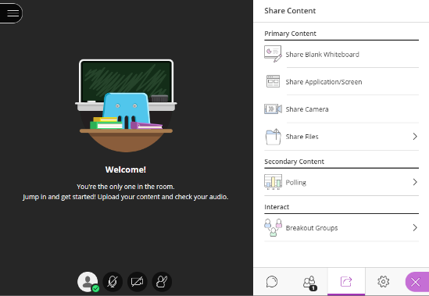
Sharing the Visualiser

Slide 14
Support
Introduction to Classroom AV Systems
Issues in room – report via x.3333 (0114 225 3333), option 1.
AV Help in Classrooms
Recording software support/training
Digital Learning Team (digitallearning@shu.ac.uk)
Digital Skills Team (digitalskills@shu.ac.uk) [Teams only]

