Slide 1
Making an allegation of academic misconduct

Slide 2
Operational Guidance
For full and detailed guidance, please use the Operational Guidance for Academic Conduct.

Slide 3
What does misconduct look like?
The Plagiarism Spectrum
Identifying Contract Cheating
Identifying AI use

Slide 4
Flow chart
This chart aims to assist colleagues in finding the right route through the academic conduct processes.
Miro chart
Visio chart

Slide 5
Categorising Misconduct
Poor academic practice
Academic concern meeting
Notice to improve
Academic misconduct
Academic conduct panel
Sanction

Slide 6
Features of Poor Academic Practice
Lack of understanding
No intent to gain unfair advantage
Low extent
Nothing to warrant further investigation
First year of study at Sheffield Hallam
Not following standard referencing
Not following assessment brief/'rubric failure'
Overuse of proof-reading service
Too much copying and pasting of source text (with inadequate attempts at referencing)

Slide 7
Definitions of academic misconduct
Plagiarism
Self-plagiarism
Contract cheating/concerns over authorship
Trading material or writing for others
Collusion
Cheating
Fabrication or falsification of data
Breaches of confidentiality
Unethical practice
Dishonest or unfair practice

Slide 8
The Plagiarism Spectrum
The Plagiarism Spectrum resource is produced by Turnitin. It identifies 10 types of plagiarism and gives clear examples of each kind. It's worth viewing online but the main types identified are:
'Clone: submitting another's work, word-for-word, as one's own'
'CTRL-C: contains significant portions of text from a single source without alterations'
'Find-Replace: changing key words and phrases but retaining the essential content of the source'
'Remix: paraphrases from multiple sources, made to fit together'

Slide 9
The Plagiarism Spectrum (continued)
'Recycle: borrows generously from the writer's previous work without citation' [self-plagiarism]
'Hybrid: combines perfectly cited sources with copied passages without citation'
'Mashup: mixes copied material from multiple sources'
'404 Error: includes citations to non-existent or inaccurate information about sources'
'Aggregator: includes proper citation to sources but the paper contains almost no original work' [This would poor academic practice rather than misconduct in SHU regulations]
'Re-tweet: includes citation, but relies to closely on the original wording/structure'

Slide 10
Process for raising a concern or making an allegation

Slide 11
Allegation proformas
Academic Conduct Notification Proforma

Slide 12
Details of concern/allegation
This needs to be specific and evidence-based.
There needs to be sufficient information to make the allegation clear to the course leader, the student and the Conduct Panel.
Bear in mind this allegation document will be seen by a lot of people: the course leader, the student, the Panel Secretary and Panel Chair, at the very least. If there is an appeal, this document will be used as part of the investigation.
Care should be taken to make the allegation clearly and impartially, using evidence.

Slide 13
Example of an allegation
The essay was submitted to TurnItIn by and it showed a score of 67%.
Further investigation shows the script has a 22% match with an essay available on a website called 'CheatsRUs' and this is not cited at all, either in the in-text references or in the reference list.
The script also shows a match of 36% with an assignment produced by this same student on another module (Potions for Beginners, 66-1234567 - BX) which they studied last year.
Two of the in-text citations (to Smith and Jones, p. 6; and to Ali, p.57) are false. The student has included them in the bibliography but these sources do not exist, and the quotations given are not from the sources indicated.

Slide 14
Examples of Kinds of Evidence
The evidence needed to support the example allegation would be:
TurnItIn report to show overall text matches with other sources;
Word document copy of essay showing highlighted problematic references to show falsified referencing;
screen shot of Cheats R Us website with highlighted section indicating match;
copy of student's previous coursework essay with highlighted section indicating match to show self-plagiarism

Slide 15
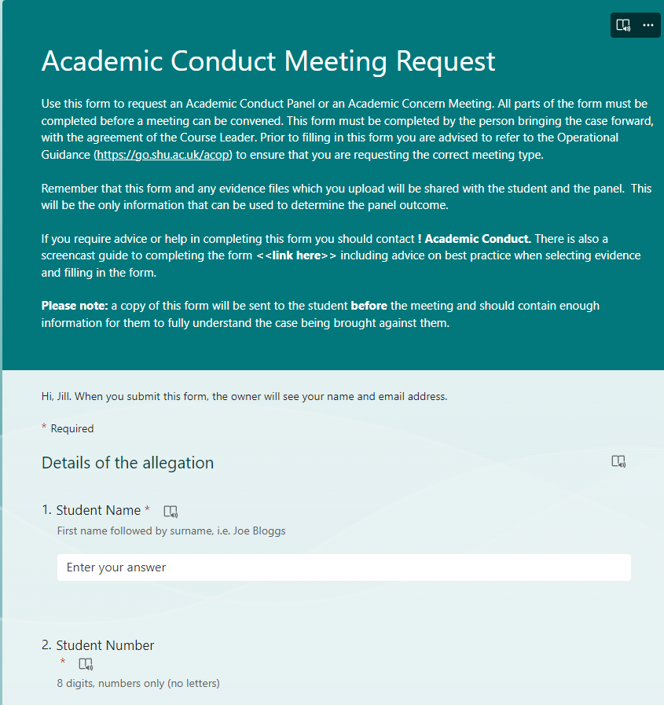
Allegation of AI misuse
You will need:
Student Name
Student Number
Course Title
Academic Department (tick list)
Module code and occurrence
Module title
Task type and number
Submission deadline
First sit or repeat attempt

Slide 16
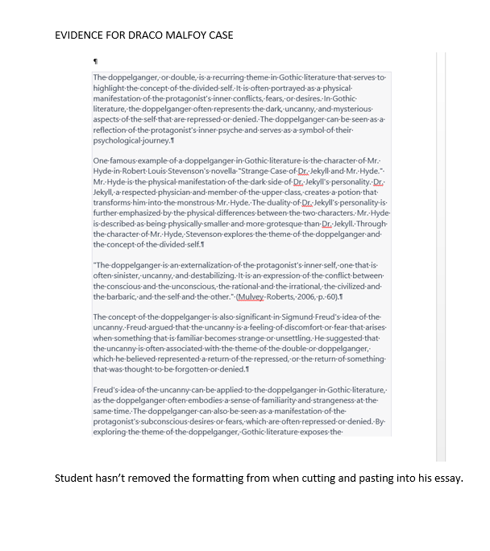
Document colour flooding

Slide 17
TurnItIn AI match

Slide 18
Extract to show student's usual written style.
In this novel, the monster is mixed in with gothic symbols, as the idea of duality is common in 18th century literature including werewolves, ghosts and vampires. In Jane Eyre the madwoman is locked in the attic and she is Bertha Mason who is Rochester’s wife but she was a slave captured from Jamaica so that Rochester could get all her money. Bertha Mason is bad luck and we can see this because the house burns down when she is in it, however Bertha and Jane are opposites and when Jane looks in the mirror in her dream she sees Bertha Mason in her wedding veil. ‘Jane Eyre’ by Charlotte Bronte uses several doubles which are characters who share similar experiences with the protagonist, Jane, for instance, there is Bertha Mason, who is the wife of Jane's employer, Mr. Rochester, and who is also a "madwoman" confined to the attic. Bertha can be seen as a double for Jane as they are both strong-willed women who are constrained by society's expectations, another example is St. John Rivers, who is a religious and disciplined man like Jane. He serves as a double for Jane because he represents her rational and intellectual side. These doubles, though different from Jane, are also similar to her in many ways, and their presence highlights Jane's struggle to define herself and her identity.

Slide 19
Further context
Try to describe what you think is most likely to have happened, given the assignment that you have to mark and any evidence that you are putting forward.
Use the TurnItIn 'plagiarism spectrum' to help you identify and describe types of plagiarism.
Remember that if you are making an allegation of contract cheating, the process and evidence might be slightly different (see slide 16).
The panel will make a decision based on the documentary evidence alone, so please include as much detail as you can.

Slide 20
Training
It is important to give details of any training the student has undergone to support their understanding of academic good practice. Please include links to any course handbooks, evidence of any training that students complete and the length of this training, assessment criteria grids showing weighting given to academic scholarship and referencing
There must be some evidence provided of appropriate support or guidance given to students around academic integrity to bring an allegation.

Slide 21
Course leader decision but remember -- you can always discuss with an experienced colleague if you need a second opinion

Slide 22
Contract cheating process
Compare with other work by the same student. Use the request to investigate contract cheating form or other guidance (see slides 17 and 18)
Use this evidence along with your subject-specialist knowledge to make an allegation to present to an Academic Conduct Panel or, if necessary, recommend a preliminary meeting
A preliminary meeting is aimed at gathering evidence, not making an allegation. Ask the student questions about the work.
Seek additional guidance if unsure what questions to ask (j.lebihan@shu.ac.uk can help to script the interview)
The Preliminary Meeting must be minuted (or recorded and transcribed) as the notes provide evidence for an Academic Conduct Panel (if warranted).

Slide 23
A Reminder about Evidence
The Office of the Independent Adjudicator Good Practice Framework stipulates that the burden of proof lies with the University.
The role of the Academic Conduct Panel is to provide an independent assessment of the evidence presented in the allegation and the explanation given by the student.
The Course Leader or Module Leader should support the tutor to bring a case, especially if the tutor is less-experienced.
The Course Leader or Module Leader should not refer a case to an ACP if there is insufficient evidence

Slide 24
Detecting Contract Cheating
Eaton, S. E. (2020). 15 Strategies to Detect Contract Cheating. Werklund School of Education,University of Calgary, Calgary, AB. pp. 1-2.
http://hdl.handle.net/1880/112660
Olu Popoola (2021) Resources for Detecting Contract Cheating. Outliar – The Deception Blog.
https://outliar.blog/2021/10/19/resources-for-detecting-contract-cheating/

Slide 25
LSEAIN Checklist
Contract cheating detection resource

Slide 26
Staff Guidance on Evidencing Misconduct
TurnItIn instructions on interrogating reports
Sheffield Hallam video instructions on analysing a TurnItIn report.
Contract Cheating Checklist (developed by the LSEAIN contract cheating working group)
Sheffield Hallam Guidance on substantiating contract cheating

Slide 27
QAA Resources on student learning and academic integrity by Mary Davis
Presentation for staff on using TurnItIn inclusively .
Mary Davis' presentation on interpreting TurnItIn reports
Round-up of useful QAA resources

Slide 28
Resources for Staff
European Network for Academic Integrity
International Centre for Academic Integrity
The Plagiarism Spectrum
QAA Academic Integrity Reports
Contract Cheating Checklist

Slide 29
Forms
Contract Cheating Request for Investigation
Academic Conduct Regulations
Allegation Forms
SHU Academic Integrity Pages

